Slide 1
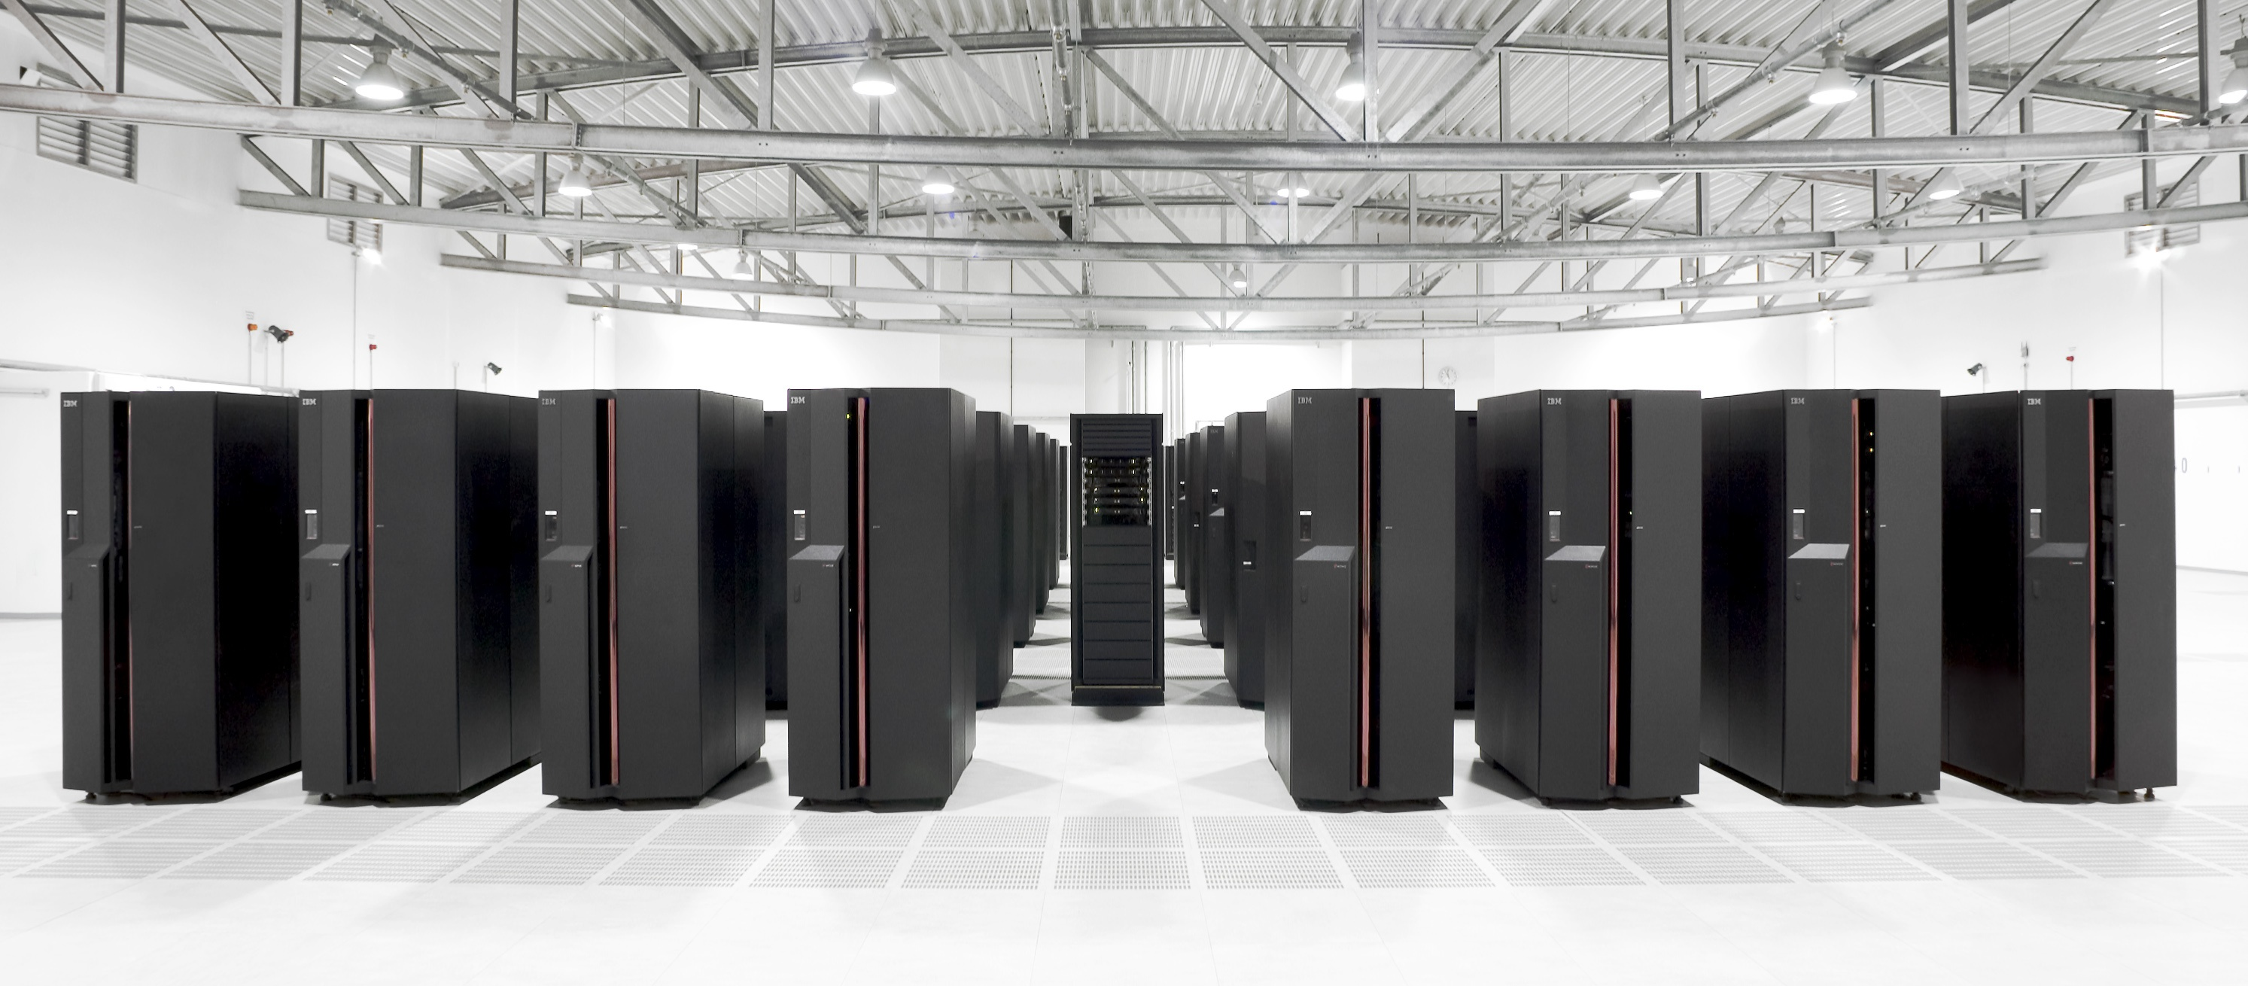
PARALLEL C
ANKITH SUDHEER KARAT
S7 CSα

Slide 2
OUTLINE
Introduction
Parallel Computing so far
Proposed Architecture
Sample Serial code
Conclusion
References

Slide 3
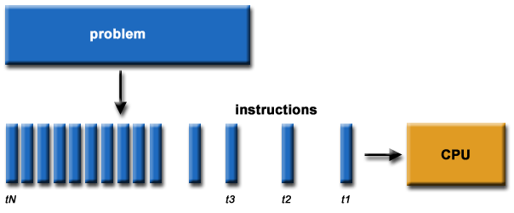
SERIAL PROCESSOR

Slide 4
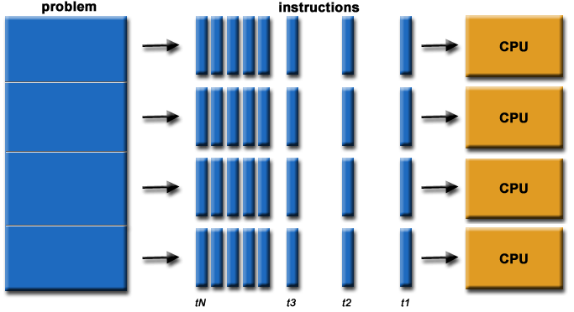
PARALLEL PROCESSOR

Slide 5
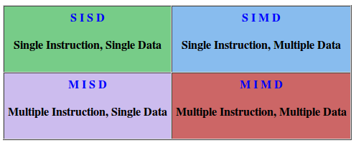
Flynn's Classical Taxonomy
There are different ways to classify parallel computers. One of the more widely used classifications, in use since 1966, is called Flynn's Taxonomy.
The matrix below defines the 4 possible classifications according to Flynn:

Slide 6
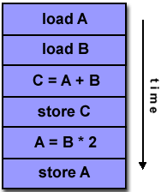
Single Instruction, Single Data (SISD):
A serial (non-parallel) computer
Single instruction: only one instruction stream is being acted on by the CPU during any one clock cycle
Single data: only one data stream is being used as input during any one clock cycle
Deterministic execution
This is the oldest and even today, the most common type of computer
Examples: older generation mainframes, minicomputers and workstations; most modern day PCs.

Slide 7
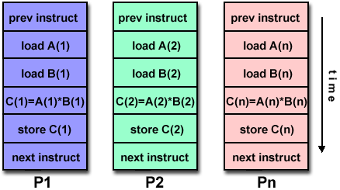
Single Instruction, Multiple Data (SIMD):
A type of parallel computer
Single instruction: All processing units execute the same instruction at any given clock cycle
Multiple data: Each processing unit can operate on a different data element
Synchronous (lockstep) and deterministic execution
Most modern computers, particularly those with graphics processor units (GPUs) employ SIMD instructions and execution units.

Slide 8
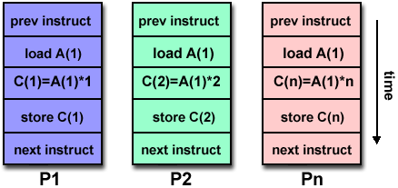
Multiple Instruction, Single Data (MISD):
A single data stream is fed into multiple processing units.
Each processing unit operates on the data independently via independent instruction streams.
Some conceivable uses might be:
Multiple frequency filters operating on a single signal stream
Multiple cryptography algorithms attempting to crack a single coded message.

Slide 9
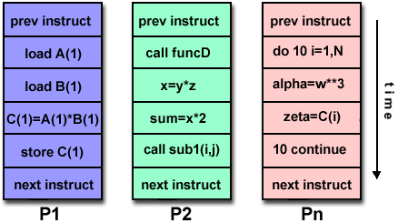
Multiple Instruction, Multiple Data (MIMD):
Currently, the most common type of parallel computer. Most modern computers fall into this category.
Multiple Instruction: every processor may be executing a different instruction stream
Multiple Data: every processor may be working with a different data stream
Execution can be synchronous or asynchronous, deterministic or non-deterministic
Examples: most current supercomputers, networked parallel computer clusters and "grids", multi-processor SMP computers, multi-core PCs.

Slide 10
PARALLEL PROGRAMMING MODELS
There are several parallel programming models in common use:
Shared Memory
Threads
Message Passing
Data Parallel
Hybrid

Slide 11
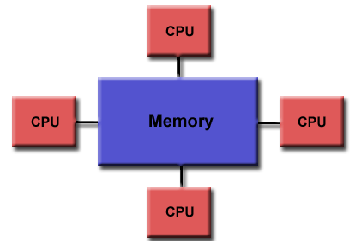
Shared Memory Model
Tasks share a common address space, which read and write asynchronously.
Locks / semaphores used to control access to the shared memory.
“Ownership" is lacking
Keeping data local to the processor that works on it conserves memory accesses, cache refreshes and bus traffic that occurs when multiple processors use the same data.

Slide 12
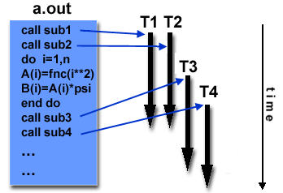
Threads Model
A single process can have multiple, concurrent execution paths.
Threads communicate with each other through global memory (updating address locations).
This requires synchronization constructs to insure that more than one thread is not updating the same global address at any time.
Threads are commonly associated with shared memory architectures and operating systems.
Example - POSIX Threads and OpenMP help in creating thread based parallel models

Slide 13
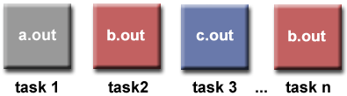
Multiple Program Multiple Data (MPMD):
MPMD is actually a "high level" programming model that can be built upon any combination of the previously mentioned parallel programming models.
MPMD applications typically have multiple executable object files (programs). While the application is being run in parallel, each task can be executing the same or different program as other tasks.
All tasks may use different data

Slide 14
Proposed Architecture for Parallel Processing
The architecture adopts all the above mentioned methodologies.
*All connected processors share a global memory.
*The tasks delegated to the processors are multi-threaded for greater parallelism.
*MIMD approach is followed.
*MPMD strategy is adopted, giving each of the associated processors a different binary file.

Slide 15
BASIC ARCHITECTURE OF PROPOSED SYSTEM
Master Processor
Dispatcher Thread
Estimator Thread
Serial Executor
P1
P2
P3
P4
P5
Shared Memory
P6
P7
. . . . . . . .
Pn
Processors P2 to Pn-1 are Slave Processors.
Update Processor
....
P2 P3 P4 P5 P6 Pn

Slide 16
The processors in the system are classified in the following categories -
Master Processor
Slave Processors
Update Processor
A single processor is by default the master processor.
Usually a single processor is alloted for the purpose of updating incomplete instructions.
The remaining processors are slave processors that work on the bulk of the code.
CLASSIFICATION OF PROCESSORS

Slide 17
Master Processor
Has primarily 3 functions which are multi-threaded
Estimator thread – Identify the program's hot-spots and bottlenecks.
-Used to estimate the total no of iterations of loops.
-Calculates approximate complexities of upcoming code blocks.
Dispatcher thread -Performs the duty of dispatching tasks to the slave processors.
-Relies on the predictions offered by the Estimator thread for allocating jobs.
-Usually allocates jobs by assigning each independent statement to a processor in a cyclic fashion.
Serial Execution Thread – This thread performs the job of a serial PC, keeping track of the current line of execution.
-This thread is responsible for the input and output of data on the screen etc.

Slide 18
Slave Processor
The dispatcher allots tasks to the various slave processors on the system.
These processors, perform the required computations using symbolic expressions.
Put simply, every unknown variable in the statement is written as a symbol. All other computations are performed.
All computed values are written onto the shared memory, for the updation process.
Update Processor
It performs the function of updating all the incomplete instructions in every processor.
It reads the updated values from the shared memory, substitutes them in the symbolic representation and completes its execution.
The computed values are stored in the symbolic table.

Slide 19
Sample Serial Code
#include <stdlib.h>
#include <stdio.h>
main(int argc, char **argv)
{
register double width, sum;
register int intervals, i;
/* get the number of intervals */
intervals = atoi(argv[1]);
width = 1.0 / intervals;
/* do the computation */
sum = 0;
for (i=0; i<intervals; ++i) {
register double x = (i + 0.5) * width;
sum += 4.0 / (1.0 + x * x);
}
sum *= width;
printf("Estimation of pi is %f\n", sum);
return(0);
}

Slide 20
Disadvantages
Wrong results may be produced
Performance may actually degrade
Much less flexible than manual parallelization
Limited to a subset (mostly loops) of code
May actually not parallelize code if the analysis suggests there are inhibitors or the code is too complex

Slide 21
CONCLUSION
Historically, parallel computing has been considered to be "the high end of computing", and has been used to model difficult scientific and engineering problems found in the real world.
Parallel C aims to bridge the gap between logic and .

Slide 22
References
[1] Stefan Boeriu, Kai-Ping Wang and John C. Bruch Jr, Parallel Computation, Proceedings of the IEEE, Vol. 96, No. 5, May 2008,page no:879-899.
[2]Brian W. Barrett, Indiana University,Ron Brightwell, Sandia National Laboratories, Jeffrey M. Squyres, Cisco Systems, and Andrew Lumsdaine, Indiana University,Implementation of Open MPI on the Cray XT3 , June 2009
[3] Hank Dietz, hankd@engr.uky.edu
v2.0, 2004−06−28, Linux Parallel Processing HOWTO
[4] https://computing.llnl.gov/tutorials/parallel_comp/index.html

